Slide 1
Smart grid
Lecture 1

Slide 2
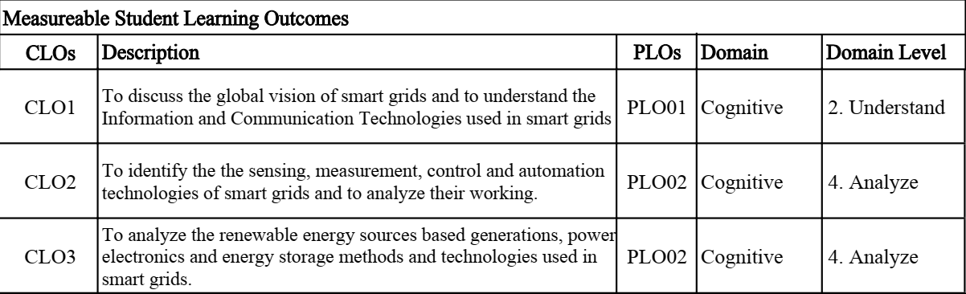

Slide 3
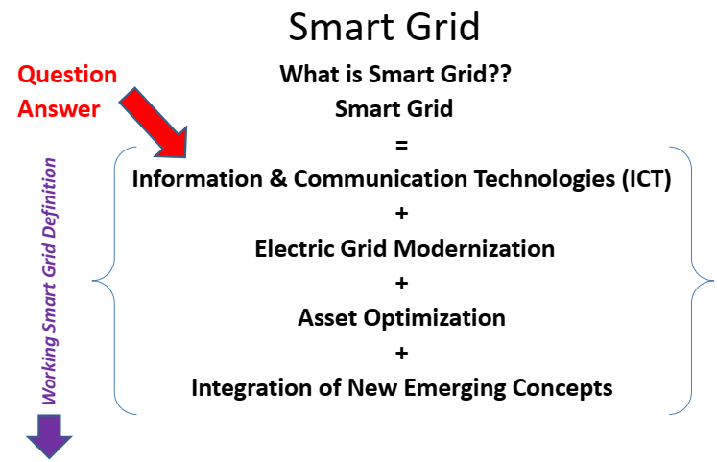
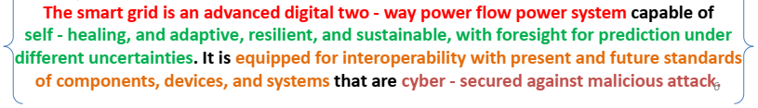
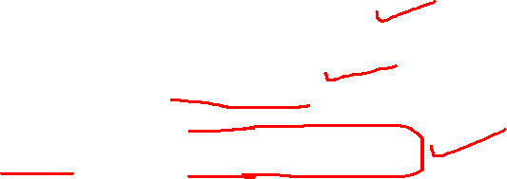
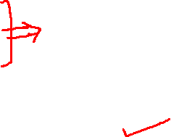
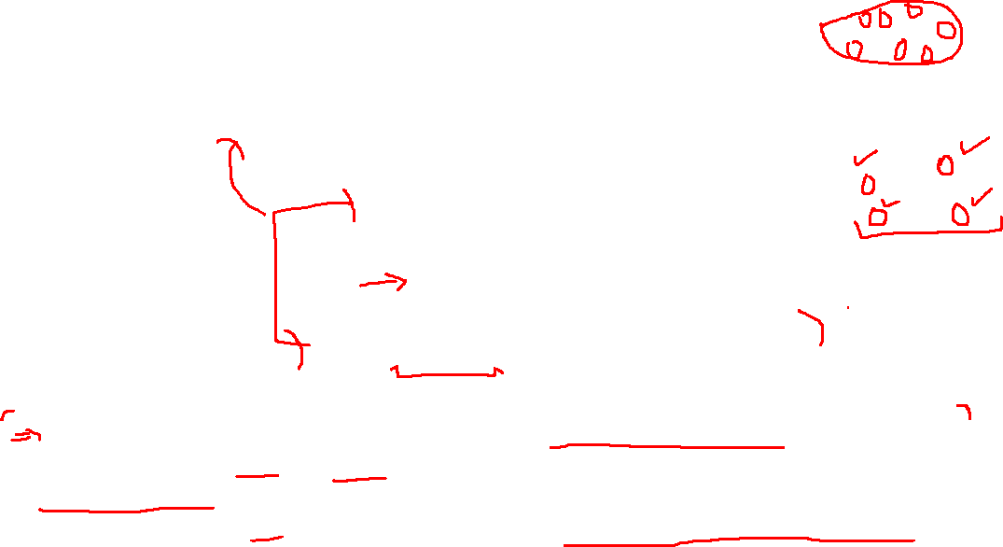

Slide 4
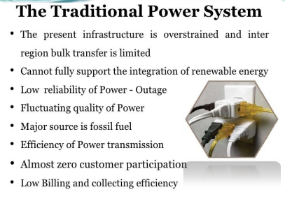

Slide 5
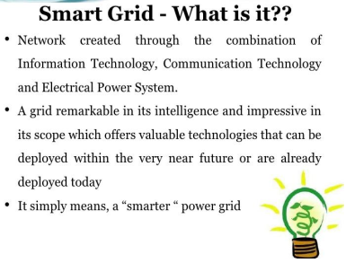

Slide 6
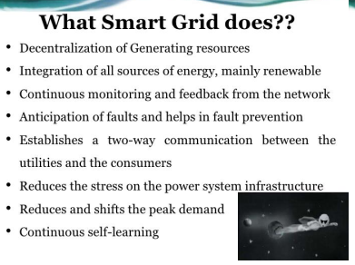

Slide 7
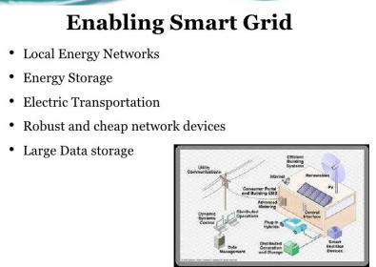

Slide 8
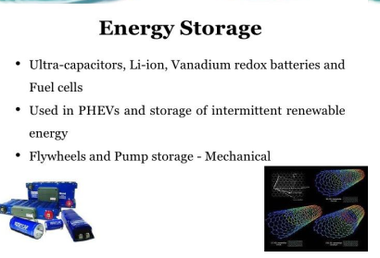

Slide 9
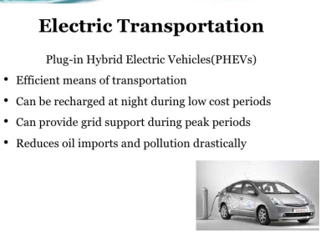

Slide 10
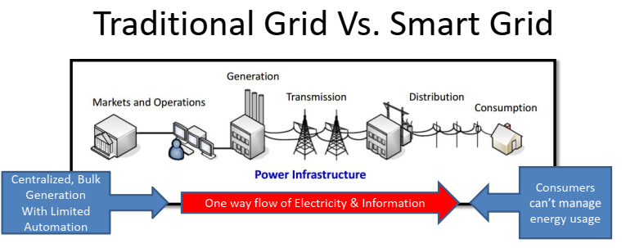
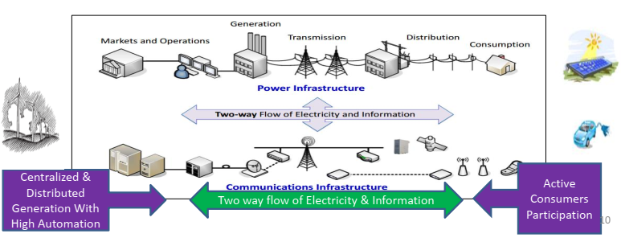
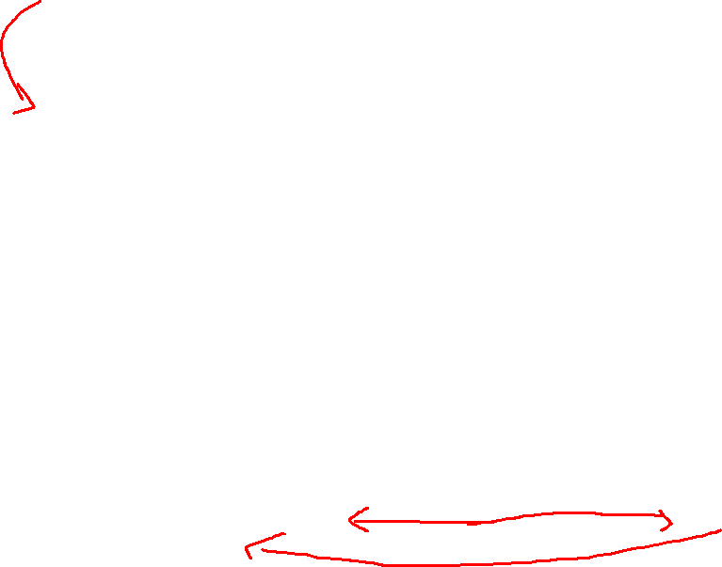
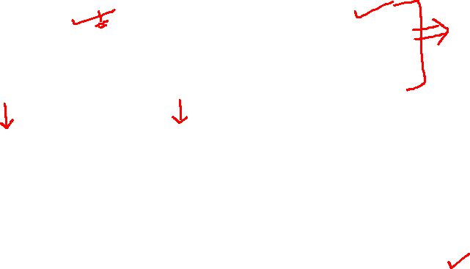

Slide 11

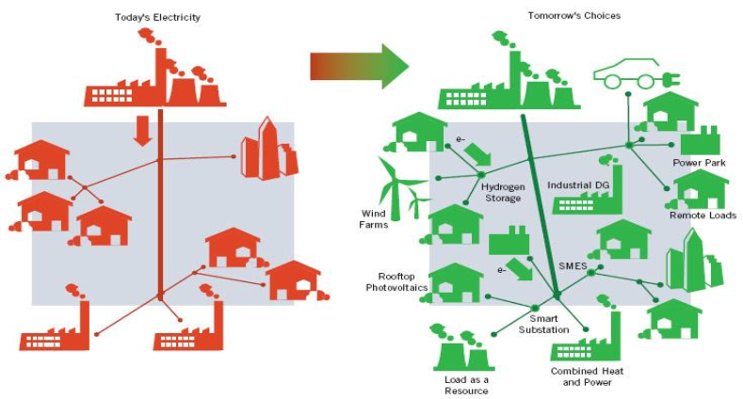

Slide 12
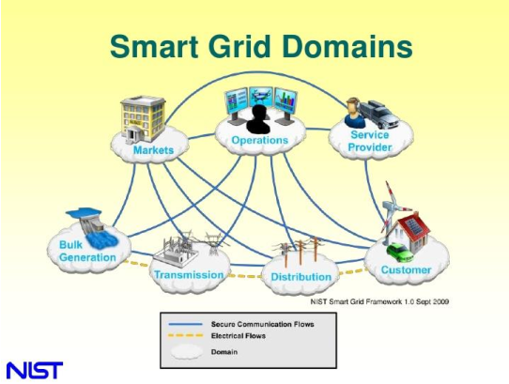

Slide 13
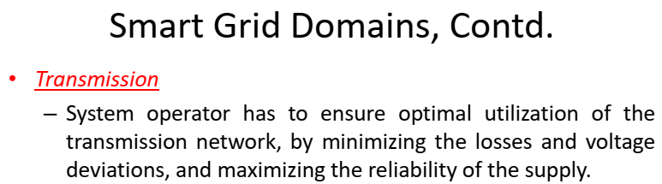
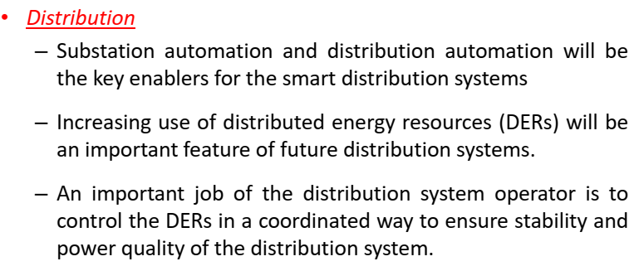

Slide 14
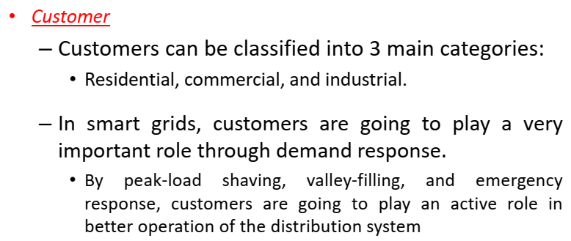
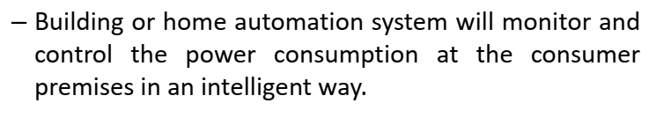

Slide 15
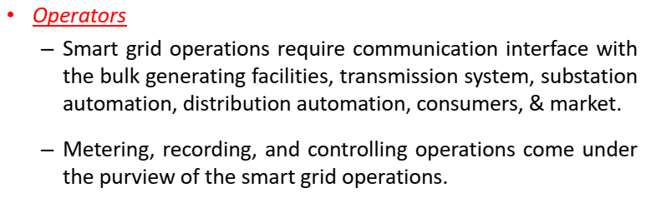
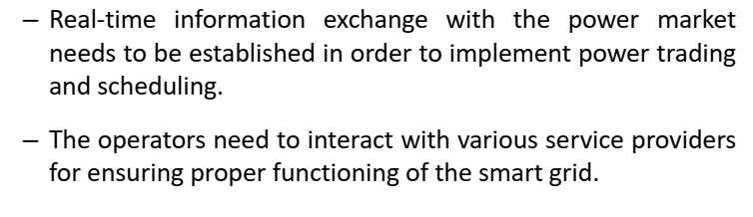

Slide 16
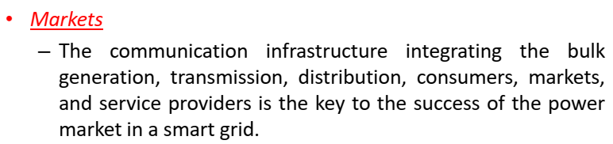
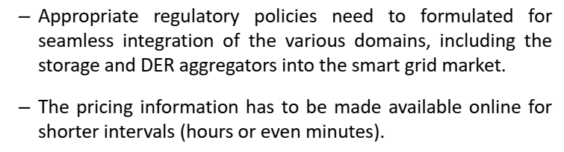

Slide 17
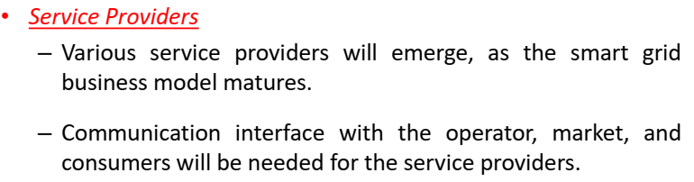
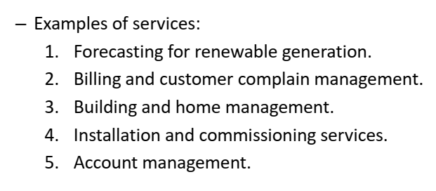

Slide 18
Transmission Grid
Established electric power systems, which have developed over the past 70 years, feed electrical power from large central generators up through generator transformers to a high voltage interconnected network, known as the transmission grid.
The distribution system, feeding load, is very extensive but is almost entirely passive with little communication and only limited local controls.

Slide 19
Why implement the Smart Grid now?
Since about 2005, there has been increasing interest in the Smart Grid. The recognition that ICT offers significant opportunities to modernise the operation of the electrical networks has coincided with an understanding that the power sector can only be de-carbonised at a realistic cost if it is monitored and controlled effectively.

Slide 20
Ageing assets and lack of circuit capacity
In many parts of the world (for example, the USA and most countries in Europe), the power system expanded rapidly from the 1950s and the transmission and distribution equipment that was installed then is now beyond its design life and in need of replacement

Slide 21
Thermal constraints
Thermal constraints in existing transmission and distribution lines and equipment are the ultimate limit of their power transfer capability. When power equipment carries current in excess of its thermal rating, it becomes over-heated and its insulation deteriorates rapidly.
This leads to a reduction in the life of the equipment and an increasing incidence of faults. The Smart Grid an overhead line passes too much current, the conductor lengthens, the sag of the catenary increases, and the clearance to the ground is reduced

Slide 22
Operational constraints
Any power system operates within prescribed voltage and frequency limits. If the voltage exceeds its upper limit, the insulation of components of the power system and consumer equipment may be damaged, leading to short-circuit faults. Too low a voltage may cause malfunctions of customer equipment and lead to excess current and tripping of some lines and generators.
The frequency of the power system is governed by the second-by-second balance of generation and demand. Any imbalance is reflected as a deviation in the frequency from 50 or 60 Hz or excessive flows in the tie lines between the control regions of very large power systems.

Slide 23
Security of supply
Modern society requires an increasingly reliable electricity supply as more and more critical loads are connected. The traditional approach to improving reliability was to install additional redundant circuits, at considerable capital cost and environmental impact. Other than disconnecting the faulty circuit, no action was required to maintain supply after a fault

Slide 24
National initiatives
Many national governments are encouraging Smart Grid initiatives as a cost-effective way to modernise their power system infrastructure while enabling the integration of low-carbon energy resources

Slide 25
China
The Chinese government has declared that by 2020 the carbon emission per-unit of GDP will reduce to 40∼45 per cent of that in 2008.
The State Grid Corporation of China (SGCC) has released a medium–long term plan of the development of the Smart Grid. The SGCC interprets the Smart Grid [2] as
“a strong and robust electric power system, which is backboned with Ultra High Voltage (UHV) networks; based on the coordinated development of power grids at different voltage levels; supported by information and communication infrastructure; characterised as an automated, and interoperable power system and the integration of electricity, information, and business flows.”

Slide 26
The European Union
The SmartGrids Technology Platform of the European Union (EU) has published a vision and strategy for Europe’s electricity networks of the future [3]. It states:
“It is vital that Europe’s electricity networks are able to integrate all low carbon generation technologies as well as to encourage the demand side to play an active part in the supply chain. This must be done by upgrading and evolving the networks efficiently and economically.

Slide 27
The Department of Energy and Climate Change document Smarter Grids: The Opportunity [4] states that the aim of developing the Smart Grid is to provide flexibility to the current electricity network, thus enabling a cost-effective and secure transition to a low-carbon energy system.

Slide 28
The Smart Grid route map [5] recognises a number of critical developments that will drive the UK electrical system towards a low carbon system. These include:
rapid expansion of intermittent renewables and less flexible nuclear generation in conjunction
with the retirement of flexible coal generation;
electrification of heating and transport;
penetration of distributed energy resources which include distributed generation, demand response and storage;
increasing penetration of electric vehicles.

Slide 29
What is the Smart Grid?
The European Technology Platform [3] defines the Smart Grid as:
“A SmartGrid is an electricity network that can intelligently integrate the actions of all users connected to it – generators, consumers and those that do both – in order to efficiently deliver sustainable, economic and secure electricity supplies.”

Slide 30
According to the US Department of Energy [7]:
“A smart grid uses digital technology to improve reliability, security, and efficiency (both economic and energy) of the electric system from large generation, through the delivery systems to electricity consumers and a growing number of distributed-generation and storage resources.”

Slide 31
In Smarter Grids: The Opportunity [4], the Smart Grid is defined as:
“A smart grid uses sensing, embedded processing and digital communications to enable the electricity grid to be observable (able to be measured and visualised), controllable (able to manipulated and optimised), automated (able to adapt and self-heal), fully integrated (fully interoperable with existing systems and with the capacity to incorporate a diverse set of energy sources).”

Slide 32
Xcel Energy’s vision [15] of a smart grid includes
“a fully network-connected system that identifies all aspects of the power grid and communicates its status and the impact of consumption decisions (including economic, environmental and reliability impacts) to automated decision-making systems on that network.”

Slide 33
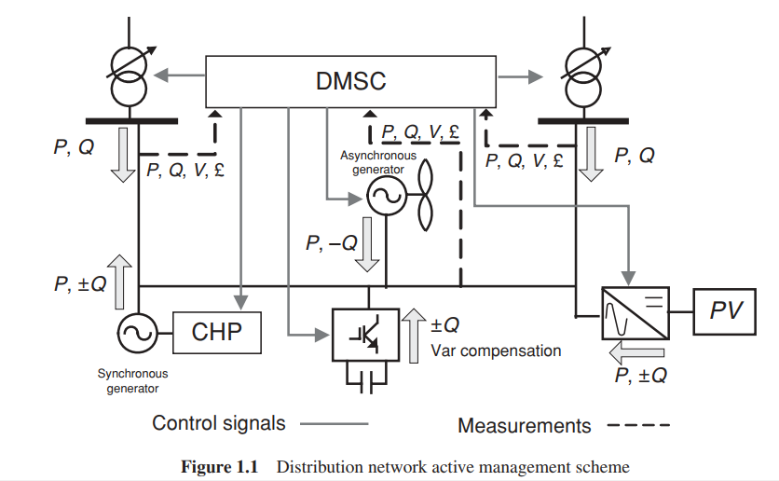
Active distribution networks

Slide 34
In this scheme a Distribution Management System Controller (DMSC) assesses the network conditions and takes action to control the network voltages and flows.
The DMSC obtains measurements from the network and sends signals to the devices under its control.
Control actions may be a transformer tap operation, altering the DG output and injection/absorption of reactive power

Slide 35
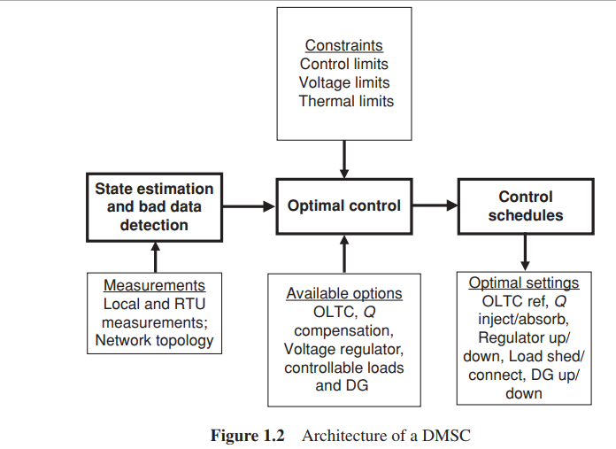

Slide 36
Figure 1.2 shows the DMSC controller building blocks that assess operating conditions and find the control settings for devices connected to the network.
The key functions of the DMSC are state estimation, bad data detection and the calculation of optimal control settings

Slide 37
The solution from the control algorithm is the optimal control schedules that are sent to the devices connected to the network. Such control actions can be single or multiple control actions that would alter the set point of any of the devices by doing any of the following:
alter the reference of an On-Load Tap Changer (OLTC) transformer/voltage regulator relay;
request the Automatic Voltage Regulator (AVR) or the governor of a synchronous generator
to alter the reactive/active power of the machine;
send signals to a wind farm Supervisory Control and Data Acquisition (SCADA) system to
decrease the wind farm output power;
shed or connect controllable loads on the network;
increase or decrease the settings of any reactive power compensation devices;
reconfigure the network by opening and closing circuit open points.

Slide 38
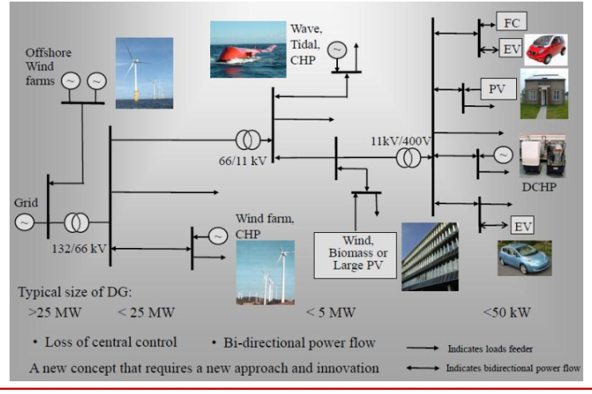

Slide 39
Virtual power plant
Distributed energy resources (DER) such as micro-generation, distributed generation, electric vehicles and energy storage devices are becoming more numerous due to the many initiatives to de-carbonize the power sector. DERs are too small and too numerous to be treated in a similar way to central generators and are often connected to the network on a ‘connect-and-forget’ basis. The concept of a Virtual Power Plant (VPP) is to aggregate many small generators into blocks that can be controlled by the system operator and then their energy output is traded

